Slide 1

Spatial Convolution
Matthew Engelhard
Many slides created by Tim Dunn
Notes:
Hi Everyone
In this lecture, we’ll take a look at the fundamental building block of the convolutional neural network: the spatial convolution operation
This is nothing more than the process we’ve considered before, in which we move a filter around an image, calculate the dot product, and record it in a feature map
We’ll spend some time actually performing some calculations to make the process a bit more clear
After that, we’ll continue to think about how CNNs identify increasingly complex features in images

Slide 2

What if we’d like to find a 1 anywhere in a larger image?
Notes:
Recall that the parameters in logistic regression and multilayer perceptron models can be viewed as filters, but those filters are the size of the entire image

Slide 3
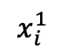
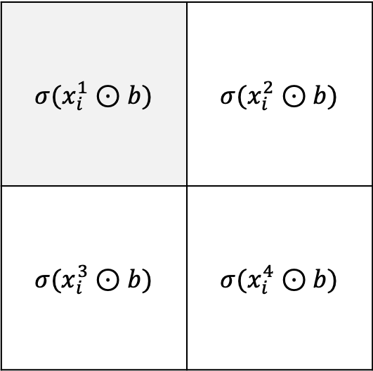

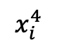
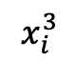
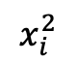
Examining filter output $σ(x_{i}^{R}⊙b)$, where $x_{i}^{R}$ is the portion of image $i$ where the filter is placed.
$$σ(x_{i}^{1}⊙b)$$ | $$σ(x_{i}^{2}⊙b)$$
$$σ(x_{i}^{3}⊙b)$$ | $$σ(x_{i}^{4}⊙b)$$
$$x_{i}^{1}$$
$$x_{i}^{2}$$
$$x_{i}^{3}$$
$$x_{i}^{4}$$
Notes:
Instead, we’d like to have a model that is based on smaller filters that can be moved around an image

Slide 4
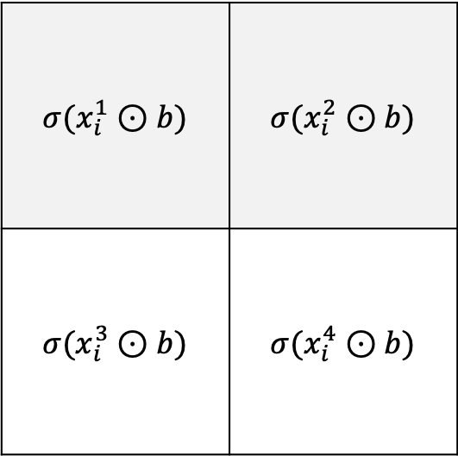
Examining filter output $σ(x_{i}^{R}⊙b)$, where $x_{i}^{R}$ is the portion of image $i$ where the filter is placed.
$$σ(x_{i}^{1}⊙b)$$ | $$σ(x_{i}^{2}⊙b)$$
$$σ(x_{i}^{3}⊙b)$$ | $$σ(x_{i}^{4}⊙b)$$
$$x_{i}^{1}$$
$$x_{i}^{2}$$
$$x_{i}^{3}$$
$$x_{i}^{4}$$
Notes:
when we apply the filter to a region of the image that does not match the filter, the resulting dot product, which we record in the feature map on the right, is near zero

Slide 5
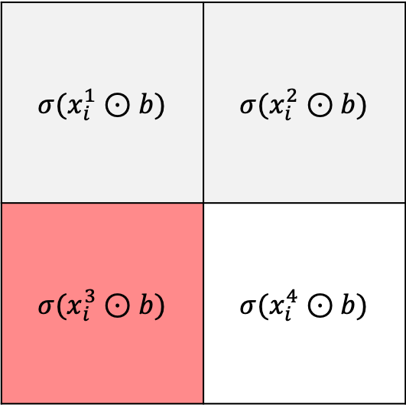
Examining filter output $σ(x_{i}^{R}⊙b)$, where $x_{i}^{R}$ is the portion of image $i$ where the filter is placed.
$$σ(x_{i}^{1}⊙b)$$ | $$σ(x_{i}^{2}⊙b)$$
$$σ(x_{i}^{3}⊙b)$$ | $$σ(x_{i}^{4}⊙b)$$
$$x_{i}^{1}$$
$$x_{i}^{2}$$
$$x_{i}^{3}$$
$$x_{i}^{4}$$
Notes:
But when the filter DOES match the image, the dot product is large, and the feature map tells us that there was a match in that location

Slide 6
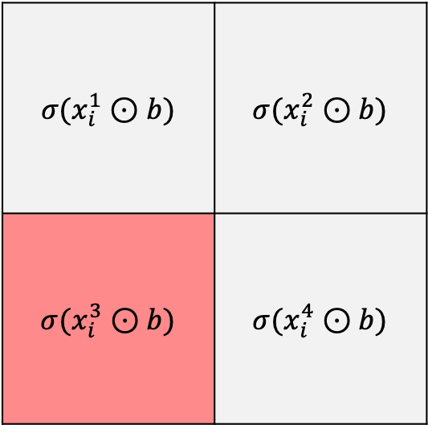
What if we want to know if a 1 is present anywhere in the image?
$$σ(x_{i}^{1}⊙b)$$ | $$σ(x_{i}^{2}⊙b)$$
$$σ(x_{i}^{3}⊙b)$$ | $$σ(x_{i}^{4}⊙b)$$
MAX
Notes:
If we want to know whether there was a match anywhere in the image, we can take the maximum value of the entire feature map

Slide 7
An Example…
filter
image
Notes:
Now let’s take a more careful look at the convolution operation
On the left, we have a small filter – just 3 x 3 pixels in size
On the right, we have an image – it’s larger than the filter, 5 x 5 pixels in total

Slide 8
An Example…
-1 | -1 | -1 | -1 | -1
-1 | -1 | -1 | 1 | -1
-1 | -1 | 1 | -1 | 1
-1 | -1 | -1 | 1 | -1
-1 | -1 | -1 | -1 | -1
-1 | 1 | -1
1 | -1 | 1
-1 | 1 | -1
filter
image
Notes:
The positive values in both the filter and the image are shown in red – specifically, red represents a value of 1
And the negative values are shown in blue – specifically, blue represents a value of -1
In a real image, we’d usually have a range of values between -1 and 1, but here we’re sticking to -1 and 1 to keep it simple
Remember that intuitively, our filter is looking for portions of the image that look like it
And from looking, we can see that there’s exactly one location in the image that looks exactly like the filter.
Once we complete our convolution operation, we expect our feature map to have a large, positive value in that location

Slide 9
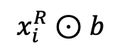
An Example…
-1
filter
image
$$x_{i}^{R}⊙b$$
Notes:
Let’s move our filter across the image, starting in the top left
We’re going to take the dot product of the filter and the portion of the image that’s right underneath it
We’ll go pixel by pixel – we look at each pixel in our filter and the image pixel underneath it
If the two match, we get a 1 when we multiply the two pixel values together
For red, it’s 1 times 1, whereas for blue, it’s -1 times -1 -- but in both cases, the result is a 1
If the two don’t match, we get a negative 1 when we multiply the two values together – negative 1 for blue times 1 for red
To get the dot product, we then add up the result
For every match, we get a 1, and for every mismatch, we get a negative 1
In the current location, we have 4 that match – these locations are blue in appearance
And we have 5 that don’t match – these locations are purple in appearance
4 matches minus the 5 mismatches gives us a negative 1 for the dot product.
We record it in the top right of our feature map.
There are 9 possible positions for our filter here – 3 vertical positions and 3 horizontal -- so our feature map is a 3 x 3 grid

Slide 10
An Example…
-1 | 5
filter
image
$$x_{i}^{R}⊙b$$
Notes:
Now let’s move our filter one space to the right.
Now we have 7 matches – red on red is red, and blue on blue is blue
And two mismatches – red on blue is purple
7 matches minus 2 mismatches gives us a dot product of 5
We record it in the corresponding location in our feature map

Slide 11
An Example…
-1 | 5 | -5
filter
image
$$x_{i}^{R}⊙b$$
Notes:
Now we move to the right again
2 matches minus 7 mismatches gives us a dot product of -5
Let’s record it in our feature map

Slide 12
An Example…
-1 | 5 | -5
3
filter
image
$$x_{i}^{R}⊙b$$
Notes:
Let’s keep going
6 matches minus 3 mismatches gives us a dot product of 3

Slide 13
An Example…
-1 | 5 | -5
3 | -5
filter
image
$$x_{i}^{R}⊙b$$
Notes:
2 matches – 7 mismatches gives us a dot product of -5
We’ll write it own in the appropriate place in our feature map

Slide 14
An Example…
-1 | 5 | -5
3 | -5 | 9
filter
image
$$x_{i}^{R}⊙b$$
Notes:
Now, finally, the exiting one – everything matches!
9 matches – 0 mismatches gives us a dot product of 9, which in this example is the largest possible value we could obtain

Slide 15
An Example…
-1 | 5 | -5
3 | -5 | 9
-1
filter
image
$$x_{i}^{R}⊙b$$
Notes:
Continuing on, here we have 4 matches and 5 mismatches for a dot product of -1

Slide 16
An Example…
-1 | 5 | -5
3 | -5 | 9
-1 | 5
filter
image
$$x_{i}^{R}⊙b$$
Notes:
Here it’s 7 matches and 2 mismatches, for a dot product of 5
And notice, this is one of two locations where there’s a pretty good match between filter and image – the dot product is fairly large -- just not as large as it is for the perfect match in the middle right

Slide 17
An Example…
-1 | 5 | -5
3 | -5 | 9
-1 | 5 | -5
filter
image
$$x_{i}^{R}⊙b$$
Notes:
Finally, we get two matches and 7 mismatches for a dot product of -5

Slide 18
An Example…
-1 | 5 | -5
3 | -5 | 9
-1 | 5 | -5
filter
image
$$x_{i}^{R}⊙b$$
Notes:
If we use a blue-red scale to color in these values, we see that the brightest parts – the highest values – are in the locations where the image matches the filter

Slide 19
Each location where the filter was centered has been evaluated: “how similar is this location to the filter”?
-1 | 5 | -5
3 | -5 | 9
-1 | 5 | -5
filter
image
$$x_{i}^{R}⊙b$$
Notes:
We’ve asked, for each location where we were able to place the filter, “how similar is this location in the image to the filter”
And the feature map is our answer.

Slide 20
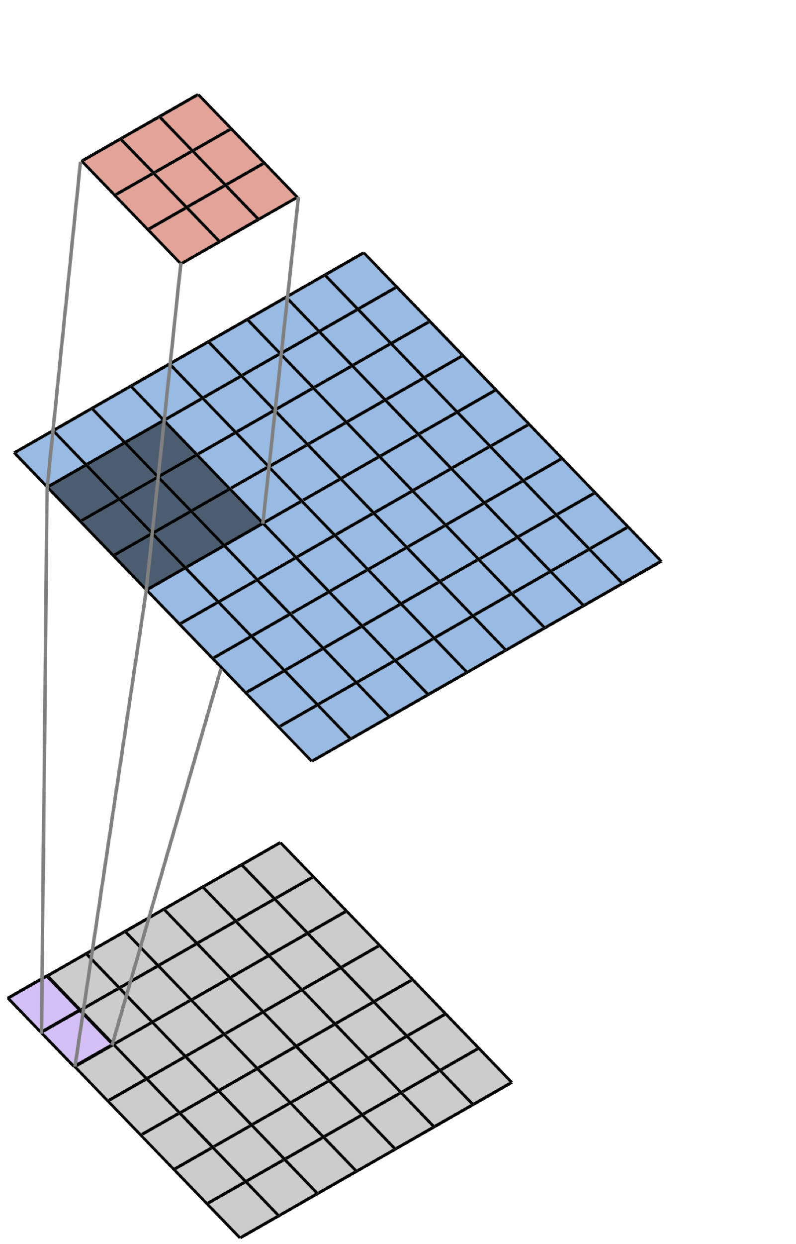
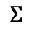

We perform “2D Spatial Convolution” as we move the filter across the image.
Filter
$$×$$
Image
$$Σ$$
Convolved Image
(Feature Map)
Notes:
Here’s another way of viewing the process we just went through, which we call “2D spatial convolution”

Slide 21
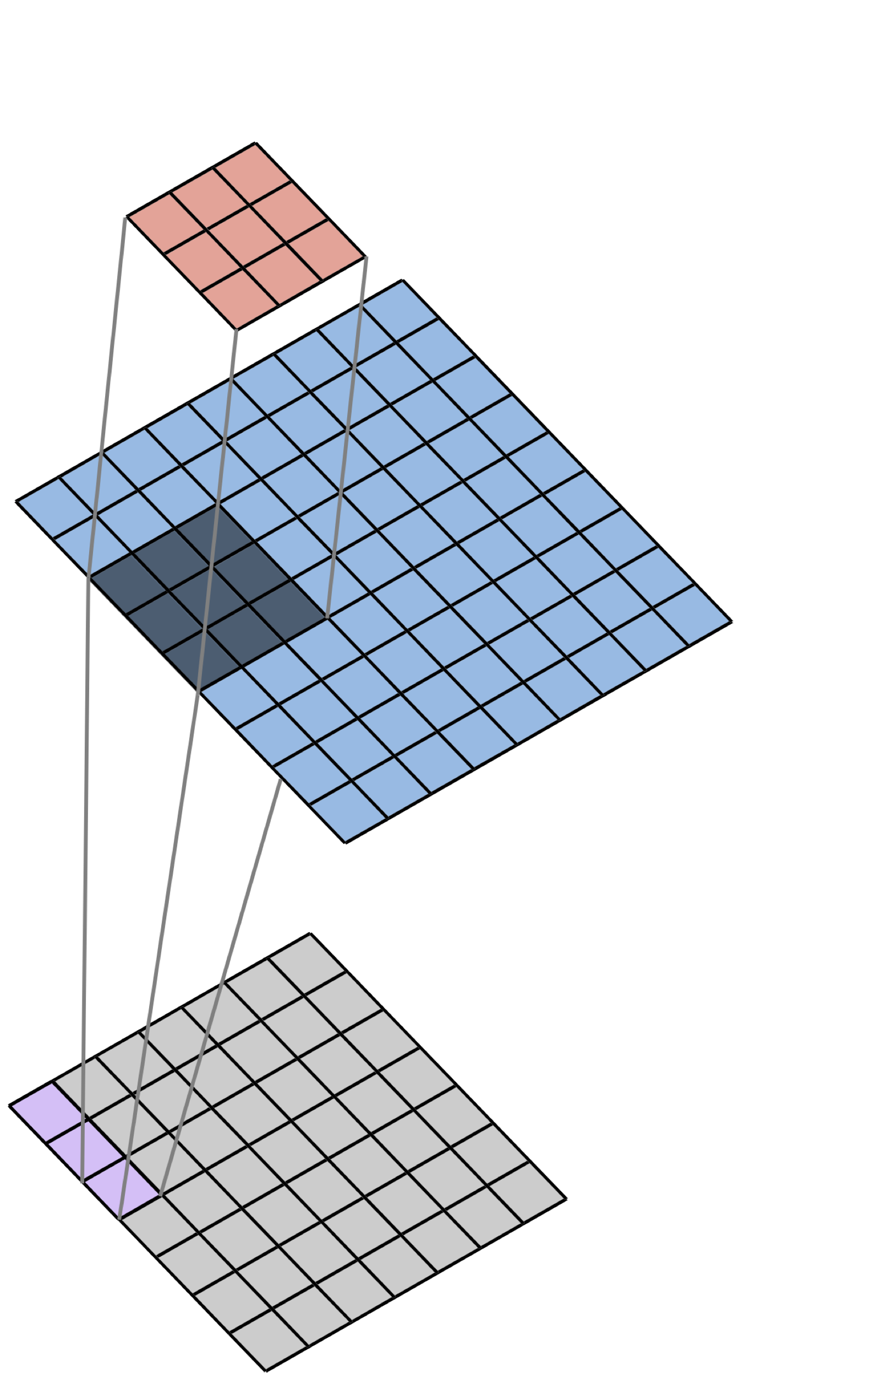
We perform “2D Spatial Convolution” as we move the filter across the image.
Filter
$$×$$
Image
$$Σ$$
Convolved Image
(Feature Map)
Notes:
This visualization helps us to see the relationship between the location of the filter, and the corresponding location in the feature map

Slide 22
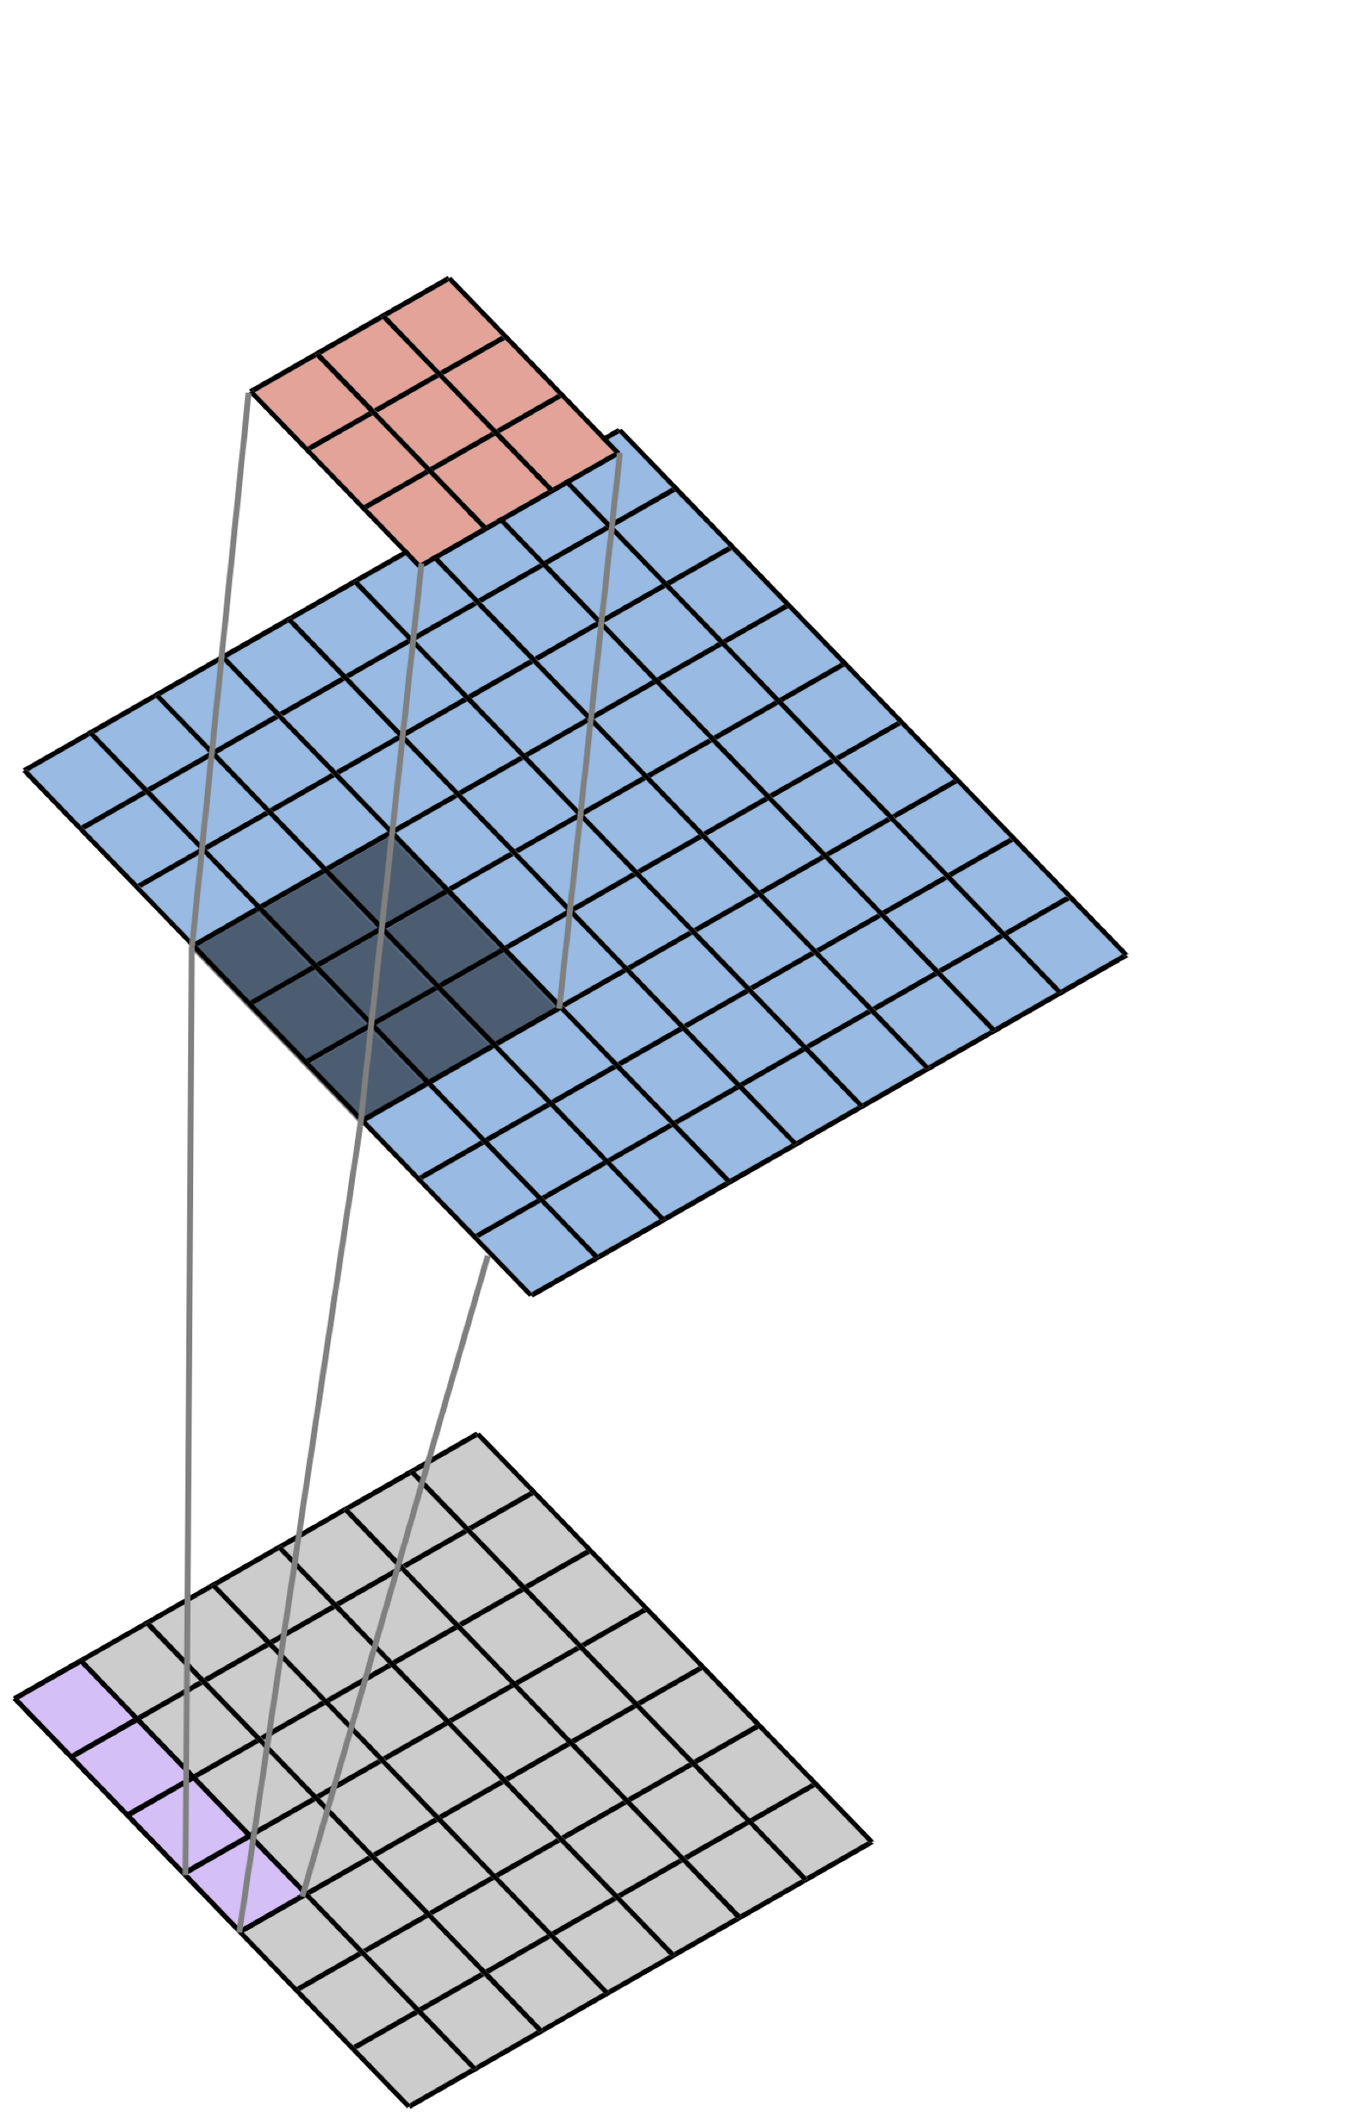
We perform “2D Spatial Convolution” as we move the filter across the image.
Filter
$$×$$
Image
$$Σ$$
Convolved Image
(Feature Map)
Notes:
The feature map is also called the ‘convolved image’:
It is the result of applying the operation we just went through, which is the convolution operation, to the image

Slide 23
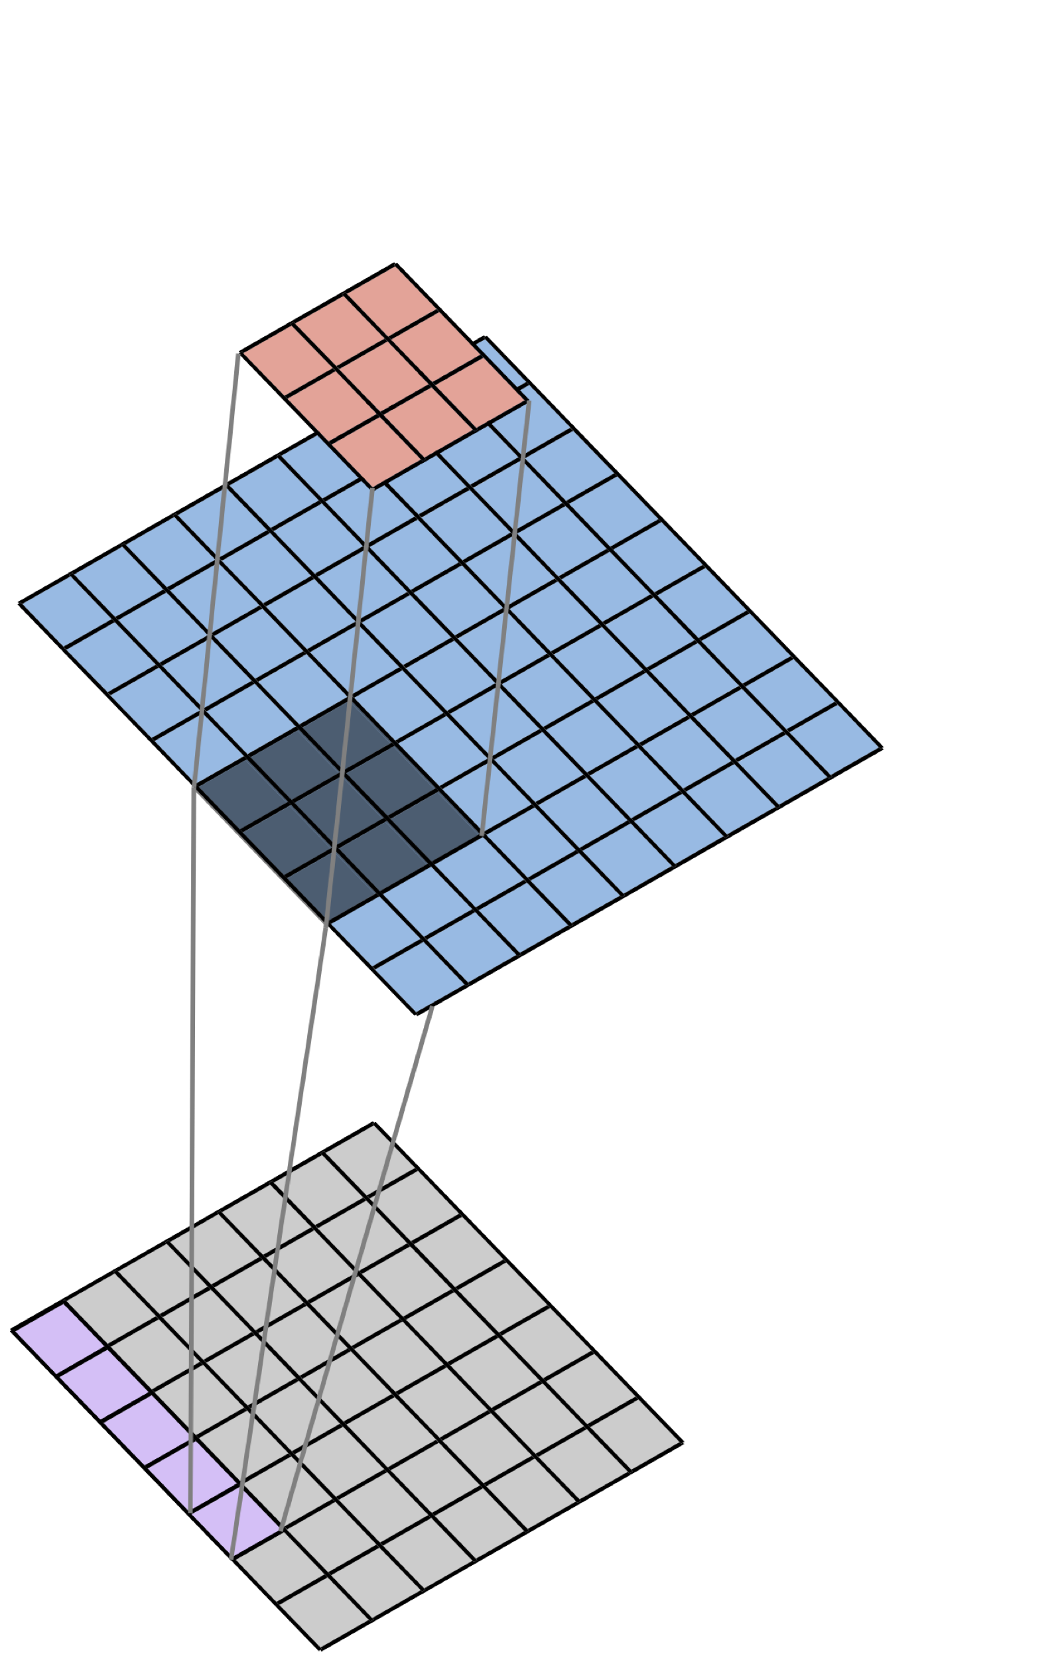
We perform “2D Spatial Convolution” as we move the filter across the image.
Filter
$$×$$
Image
$$Σ$$
Convolved Image
(Feature Map)
Notes:
Each filter gives us a different feature map – a circle-shaped filter gives us a feature map showing the locations of all the circles in the image
A triangle-shaped filter gives us a feature map showing the locations of all the triangles in the image

Slide 24
“1” filter output
“0” filter output
In this way, we learn to identify a hierarchy of features rather than a huge number of complex features
Notes:
And if we want to identify combinations of features – a triangle next to a circle, or a 1 next to a zero – we can consult the respective feature maps and look for places where a bright spot on the triangle feature map is right next to a bright spot on the circle feature map
We’ll continue to discuss this idea – the idea of hierarchical features – in the rest of this lecture as well as the next one
However, we WON’T be returning to the convolution operation
To become more comfortable with this operation, it may be helpful to try a few examples on your own that are similar to the example we went through a moment ago. Try replacing the cross with another shape – or changing the image -- and see what feature map you end up with

Slide 25
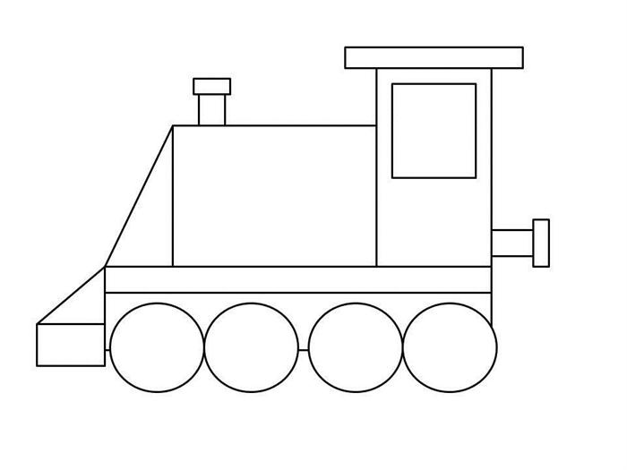
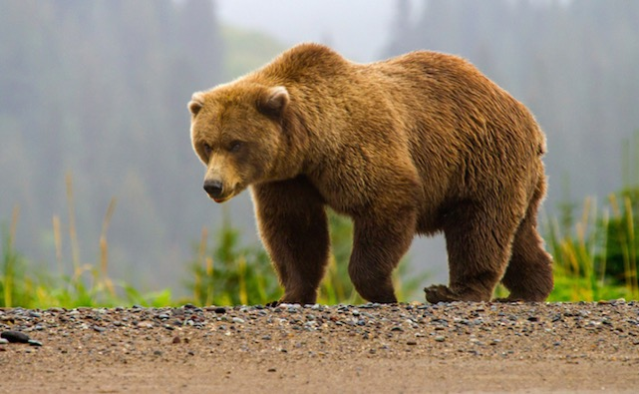
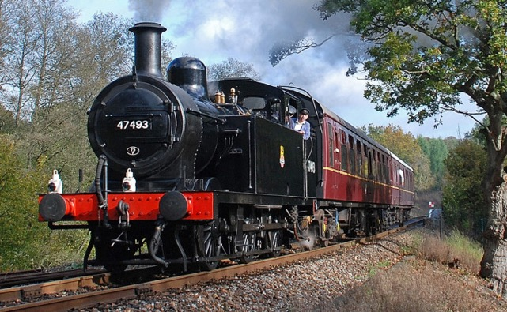
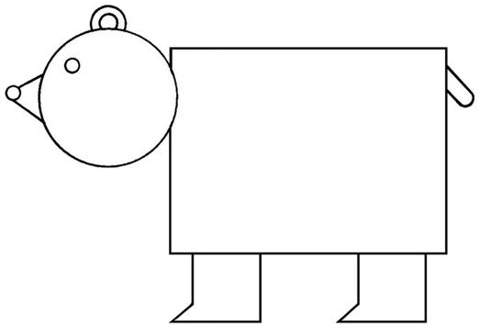
CNNs Take Advantage of Repeated, Hierarchical Structure in Images
Notes:
The big question is – what does this have to do with identifying real objects in real images?
Here we have a picture of a bear on the left and a train on the right
And we’d like to have a model that can identify each one – a model that can distinguish bears from trains, or squamous cell carcinomas from actinic keratoses
We know how to identify circles and triangles, but what good is that here?
What I hope to convince you of – and is empirically true – is that although these objects are quite different, they are composed of the same set of simple building blocks, arranged in different ways

Slide 26
CNNs Take Advantage of Repeated, Hierarchical Structure in Images
Notes:
Let’s take a look at a simplified version of these images
At a high level, the two look completely different
But if we zoom in closely, we start to identify some common patterns

Slide 27
CNNs Take Advantage of Repeated, Hierarchical Structure in Images
Low-level structure: lines, curves
Notes:
In both cases, we have a number of vertical lines

Slide 28
CNNs Take Advantage of Repeated, Hierarchical Structure in Images
Low-level structure: lines, curves
Notes:
And then a number of diagonal lines
We also have some curved lines, some horizontal lines, and some diagonal lines slanted the opposite way

Slide 29
CNNs Take Advantage of Repeated, Hierarchical Structure in Images
Mid-level structure: shapes
Notes:
Both images contain some triangular shapes – maybe these could be recognized directly with a triangular filter, or maybe they would be recognized as combinations of horizontal, vertical, and diagonal lines

Slide 30
CNNs Take Advantage of Repeated, Hierarchical Structure in Images
Mid-level structure: shapes
Notes:
Both have circular shapes
In the bear, we have a single circle in isolation, whereas in the train, we have four circles in sequence
Supposing we had a feature map showing the location of all the circles, the feature map would show a single bright spot for the bear, and four consecutive bright spots for the train

Slide 31
CNNs Take Advantage of Repeated, Hierarchical Structure in Images
High-level structure: groups of shapes
Notes:
Although both bear and train have circles and rectangles, the arrangement of these shapes in relation to one another is very different between them
A single circle next to a single large rectangle is more suggestive of a bear, whereas four consecutive circles partially bounded by a smaller rectangle is more suggestive of a train

Slide 32
CNNs Take Advantage of Repeated, Hierarchical Structure in Images
Bear
Train
High-level structure: groups of shapes → objects
Notes:
Both images have low-level features in common, but the way in which these lower-level features are arranged to form higher level features is quite different between them
We call this repeated, hierarchical structure. Repeated in that low-level features appear over and over
Hierarchical in that complex features are composed of specific arrangements of simpler features

Slide 33
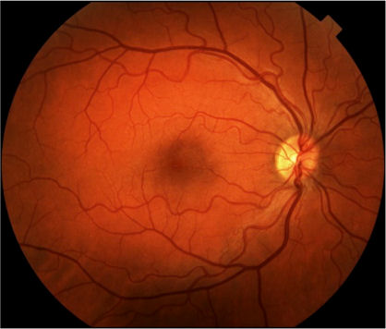
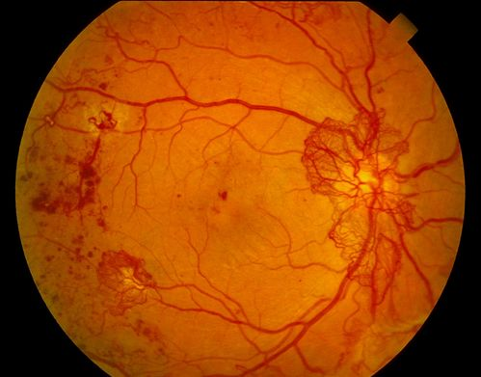

Deep Learning for Image Analysis
Diabetic Retinopathy Classification
Healthy Retina
Unhealthy Retina
Notes:
Medical images are no different – at the lowest level, we have lines and shapes
These come together to form cells and tissues
which, arranged in specific patterns, form recognizable biological structures.
In the next lecture, we’ll see how the CNN takes advantage of this hierarchy

Slide 34
Summary
The convolution operation is the building block of the convolutional neural network (CNN)
Convolving an image with a filter gives us a feature map that tells us how much each region of the image matches the filters
CNNs learn to recognize high-level structure in images by building hierarchical representations of features

